Slide 1
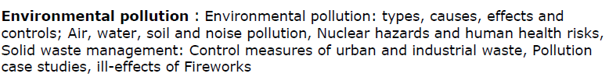
Pollution and Solid Waste

Slide 2
Pollution is the introduction of contaminants into the natural environment that cause adverse change. Pollution can take the form of chemical substances or energy, such as noise, heat or light.
Pollutants, the components of pollution, can be either foreign substances/energies or naturally occurring contaminants.

Slide 3
Types of Pollution
Air Pollution
Water Pollution
Soil Pollution
Noise Pollution
Radiation Pollution

Slide 4
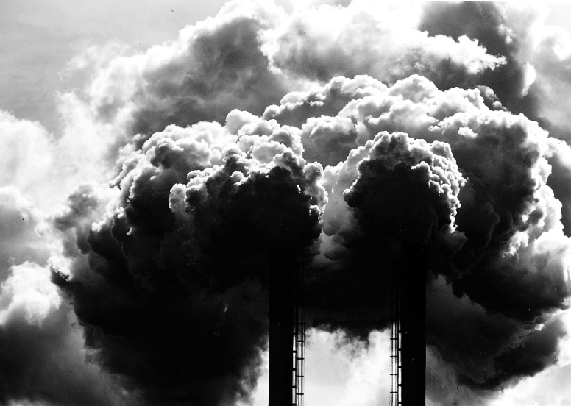
Air Pollution

Slide 5
Air pollution is said to exist if the levels of gases, solids, or liquids present in the atmosphere are high enough to harm humans, other organisms, or materials.

Slide 6
Air Pollutants
Primary air pollutants: harmful chemicals that are released directly from a source into the atmosphere.
Particulate matter such as soil particles, lead, and asbestos.
Oxides of carbon and nitrogen and sulphur dioxide
Hydrocarbons like methane and benzene
Secondary air pollutants: produced from chemical reactions involving the primary pollutants.
Ozone
Sulphur trioxide

Slide 7
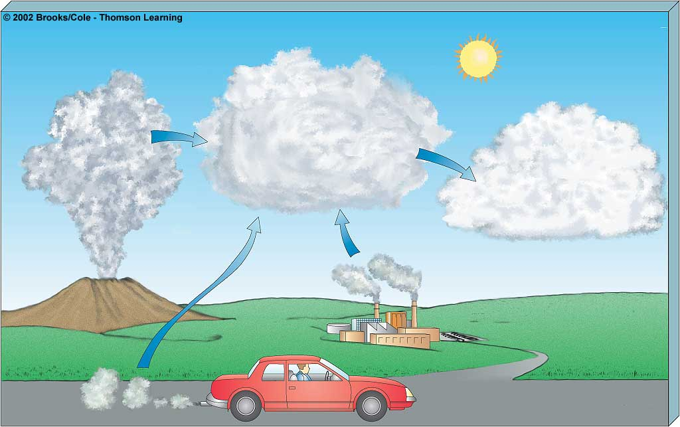
Primary Pollutants
CO
CO₂
Secondary Pollutants
SO₂
NO
NO₂
SO₃
Most hydrocarbons
HNO₃
H₂SO₄
Most suspended
particles
H₂O₂
O₃
₂
and
–
salts
Most
NO₃
SO₄
–
Mobile
Natural
Sources
Stationary

Slide 8
Major Air Pollutants
Carbon Monoxide
Carbon Dioxide
CFCs
Ozone
Nitrogen oxide
Sulphur dioxide
Suspended Particulate Matter (SPM)

Slide 9
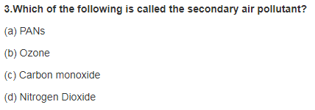

Slide 10
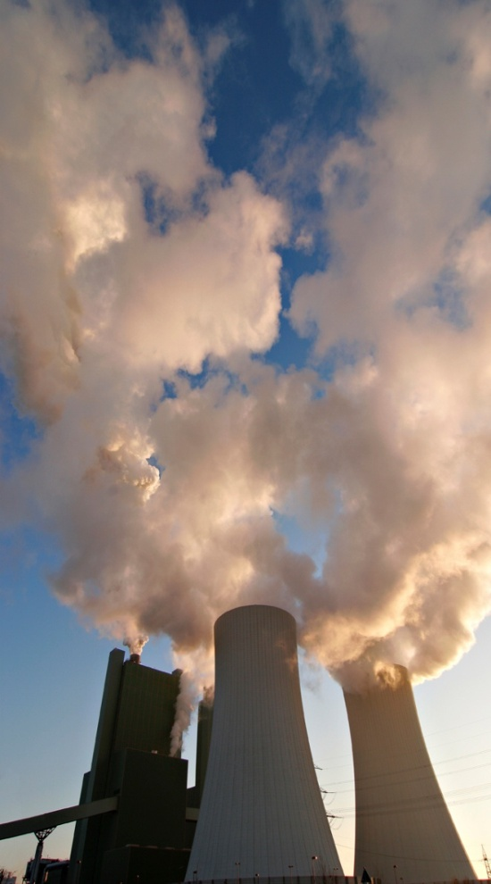
Air Pollution
Causes of Air Pollution
→Natural Causes-
Natural disasters like volcanic eruption, cyclones, forest fires, microbes(CH₄)
Natural emissions from animals, decaying organic matter
→Man made Causes-
Industrial emissions
Automobiles
Thermal power stations
Nuclear explosions
Nuclear power plants
Agricultural activities
Disposal of garbage
Mining activities

Slide 11
Effects of Air Pollution
Effects on Human Health
Carboxyhaemoglobin
Inflammation of lungs
Damage to respiratory system, and blood vascular system,
Different types of cancers
Effects on Plants
Bleaching of the leaf pigment
Development of necrotic spots
Premature falling of leaves
Effects on Climate
Greenhouse effect and global warming
Acid rain
Ozone (O₃) layer depletion

Slide 12
Reducing and controlling air pollution
Air pollution can be reduced by
Adopting cleaner technologies,
Reducing pollution at the source,
Implementing laws and regulations to make people pollute less,
Introducing appropriate transportation policies
Making cleaner and fuel-efficient vehicles
Particulate matter in the air can be reduced by:
fitting smokestacks with electrostatic precipitators, fabric filters, scrubbers, or similar devices
Sprinkling water on soil that is being evacuated during road construction

Slide 13
Related links
Photochemical smog
http://study.com/academy/lesson/photochemical-smog-definition-formation-effects.html
https://www.youtube.com/watch?v=2WF2aMbAcNc
Air Pollution Causes, Effects And Solutions
https://www.youtube.com/watch?v=bTsxx1KZwlM

Slide 14
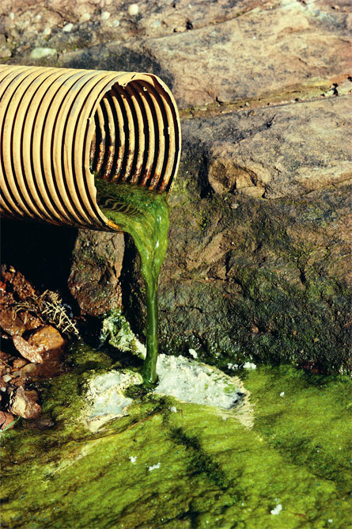
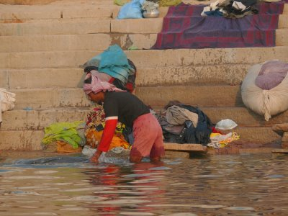
Water Pollution
The addition of various organic and inorganic substances that change the
physical and chemical properties of water thereby leading to detrimental effects on living organisms and reducing water usability is termed as water pollution.

Slide 15
Causes of Water Pollution
Natural Causes-
Soil erosion due to rain, floods, high speed wind.
Deposition of dead and decaying remains of plants and animals.
Man-made Causes-
Sewage and other wastes- Includes papers, cloth, soap, detergents, waste.
Industrial waste- effluents such as oil, grease, plastic, metals, acids and other toxic chemicals.
Agricultural waste – fertilizers, pesticides.
Human activities – bathing, clothing, washing.
Customs and traditions- disposal of dead bodies, immersion of idols of gods.

Slide 16
Sources of water pollutants
Point sources-Pollutants enter the water at a single point-- sewage treatment plant and factories. These can be regulated through law.
Non point source- pollutants enter the water over large areas--Surface run off, mining wastes, municipal wastes, acid rain and soil erosion.

Slide 17
1. Which of the following facts are incorrect?
Global warming is the rise in the average temperature of the earth’s climate system
Eutrophication is observed in water bodies
The greenhouse effect is a natural phenomenon
Ozone is harmless to breathe
2. Areas that are under the influence of DDT may observe a decline in the population of birds. This is due to the fact that
Birds stopped laying eggs altogether
The eggs did not hatch
Predation of the eggs increased
None of the above.
3. Measuring BOD (biological oxygen demand) is primarily used for
Estimating the types of microbes
Determine the level of dissolved oxygen
Estimating the quantity of organic matter in sewage water
None of the above
4. Cosmic rays, such as gamma rays are a source of
Soil Pollution
Noise Pollution
Thermal Pollution
Radiation pollution

Slide 18
1. Which of the following facts are incorrect?
Global warming is the rise in the average temperature of the earth’s climate system
Eutrophication is observed in water bodies
The greenhouse effect is a natural phenomenon
Ozone is harmless to breathe
2. Areas that are under the influence of DDT may observe a decline in the population of birds. This is due to the fact that
Birds stopped laying eggs altogether
The eggs did not hatch
Predation of the eggs increased
None of the above.
3. Measuring BOD (biological oxygen demand) is primarily used for
Estimating the types of microbes
Determine the level of dissolved oxygen
Estimating the quantity of organic matter in sewage water
None of the above
4. Cosmic rays, such as gamma rays are a source of
Soil Pollution
Noise Pollution
Thermal Pollution
Radiation pollution

Slide 19
5. The primary agenda of the Kyoto protocol is
Regulation of hazardous wastes
Regulate the production of nuclear energy
Control anthropogenic sources of greenhouse gases
None of the above
6. The presence of _________ in a water body is an indicator of water pollution.
Zygosporangium
E.Coli
Deinococcus radiodurans
None of the above
7. Eggshells of birds become unusually thin when exposed to the pesticides in their environment. The protein that gets affected is ________
Calmodulin
Cysteine
Serine
None of the above
8. Lichens are good bioindicators for
Environmental radiation
Soil pollution
Water and air pollution
None of the above

Slide 20
5. The primary agenda of the Kyoto protocol is
Regulation of hazardous wastes
Regulate the production of nuclear energy
Control anthropogenic sources of greenhouse gases
None of the above
6. The presence of _________ in a water body is an indicator of water pollution.
Zygosporangium
E.Coli
Meningococcus radiodurans
None of the above
7. Eggshells of birds become unusually thin when exposed to the pesticides in their environment. The protein that gets affected is ________
Calmodulin
Cysteine
Serine
None of the above
8. Lichens are good bioindicators for
Environmental radiation
Soil pollution
Water and air pollution
None of the above

